Slide 1
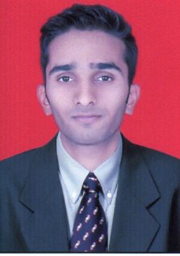
ADITYA RAHATEKAR
Name : Aditya Rahatekar
Job Title/Level :Technical specialist: Trainee
Tieto Tenure :1 Month
Total Experience :Fresher
Qualification :B.E (Electronics)
Name : Aditya Rahatekar
Job Title/Level :Technical specialist: Trainee
Tieto Tenure :1 Month
Total Experience :Fresher
Qualification :B.E (Electronics)
Highlights
I have completed B.E in Electronics.
Cisco Certification course.
Microsoft Certification course.
Red-hat Certification course.
Good knowledge of html and its scripting.
Accomplishments/Achievements/Awards
Career Interests
Automation & orchestration
DevOps
SME in Data Security
Strengths
Learning Attitude
Solution Oriented
Team player

Slide 2
DevOps
Aditya Rahatekar
Trainee
Tieto Oyj, ZST Technology Services and Modernization / ZSTEO DevOps & TECO
aditya.rahatekar@tieto.com

Slide 3
Table of contents
DevOps
What DevOps is not.
DevOps Flow Chart.
DevOps Tools & Process.
SDLC

Slide 4
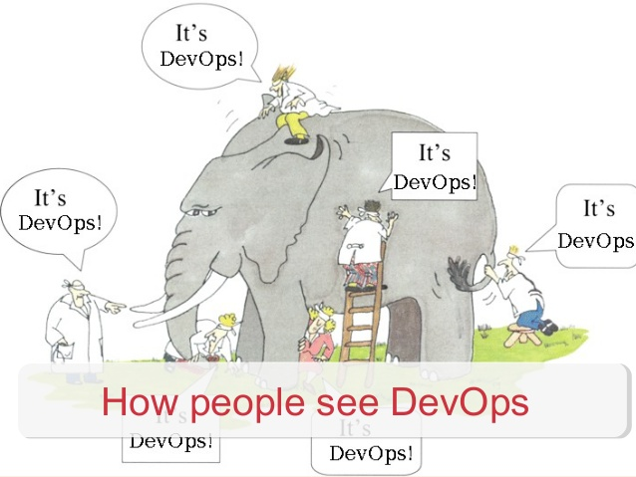

Slide 5

DevOps

Slide 6
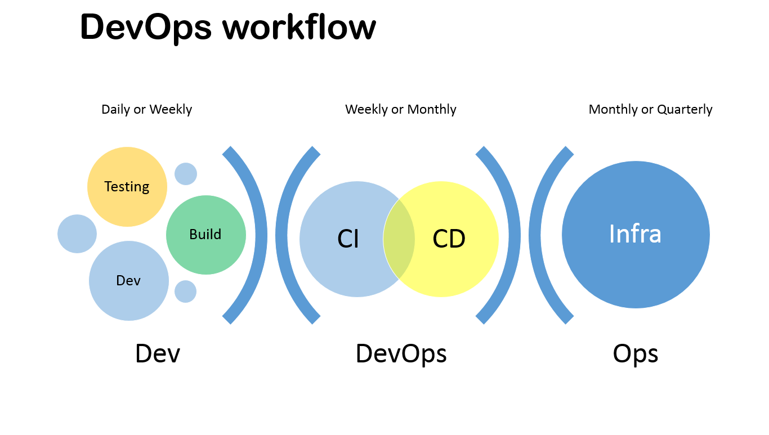

Slide 7
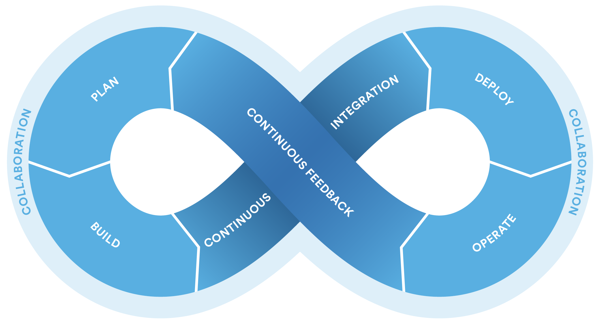

Slide 8
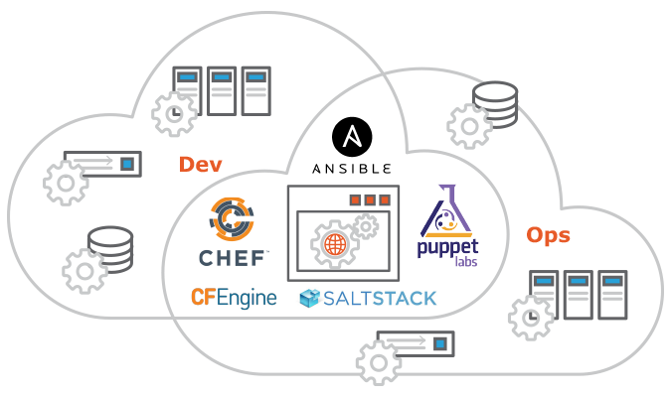
Dev-Ops Tools

Slide 9
Summery :-

Slide 10
Aditya Rahatekar
Trainee
Tieto Oyj, ZST Technology Services and Modernization / ZSTEO DevOps & TECO
aditya.rahatekar@tieto.com

